Slide 1
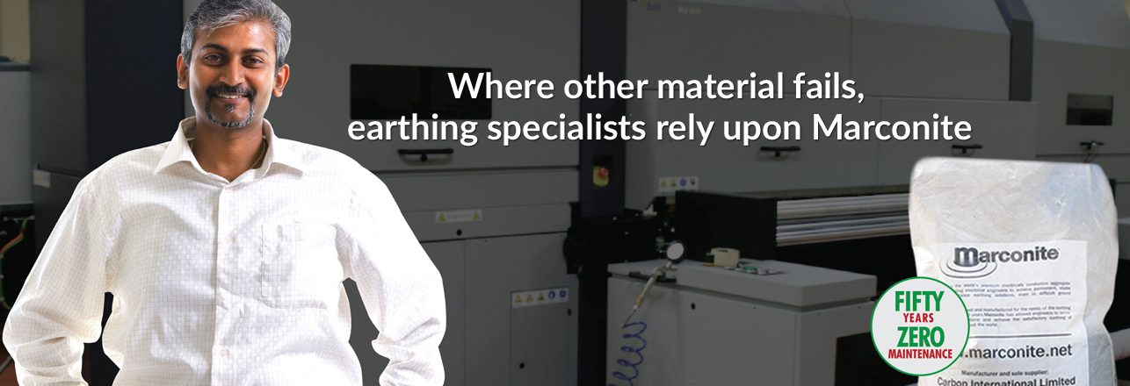
INTER-TECH
Providing Earthing for
www.intertech.com.co

Slide 2
INTER-TECH
TOPICS FOR DISCUSSION
1
Objective of Earthing
5
Myths & Misconceptions
Earth Enhancement Material
6
Marconite in Power and Solar Sector
2
Advantage of MARCONITE Earth Enhancement Material
7
Common Mistakes & Do’s and Don’t
3
4
Earthing Design Inputs
8
Question & Answer
www.intertech.com.co

Slide 3
Objective of Earthing
INTER-TECH
Ensuring Safe Operation of Power System.
Ensuring Safety of Machine & Men.
Eliminating Electrostatic Accidents.
Reducing Electro Magnetic Interference
www.intertech.com.co

Slide 4
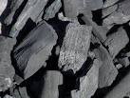
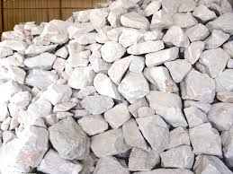
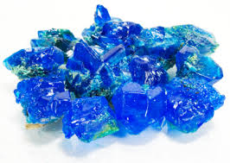
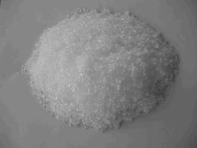
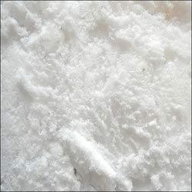
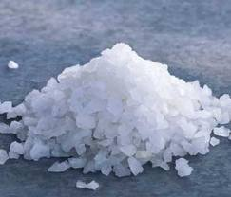
INTER-TECH
Earth Enhancing / back fill materials in use :
Charcoal and Salt, Sodium Carbonate, Calcium Carbonate,
Calcium Sulphate, Copper Sulphate, Bentonite.
Charcoal & Salt
Calcium Carbonate
Copper Sulphate
Sodium Carbonate
Calcium Sulphate
Sodium Bantonite
www.intertech.com.co

Slide 5
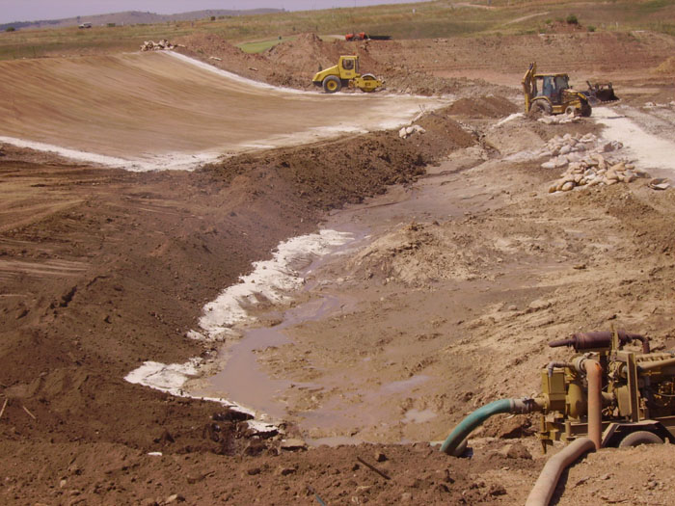
Bentonite Earth Enhancement Material?
INTER-TECH
Bentonite is now used as a general name for water absorbing clay which usually contains mostly montmorillonite.
www.intertech.com.co

Slide 6
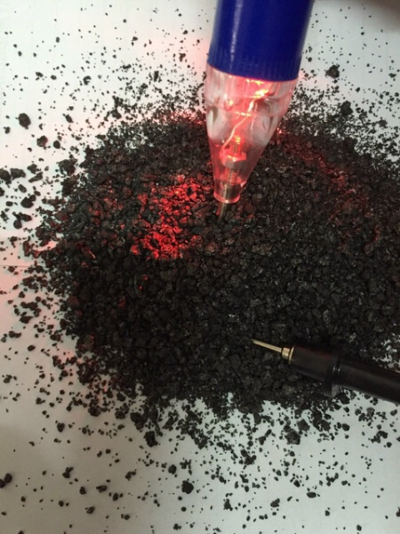
INTER-TECH
New Earth Enhancement Material
Electrically Conductive Aggregate
www.intertech.com.co

Slide 7
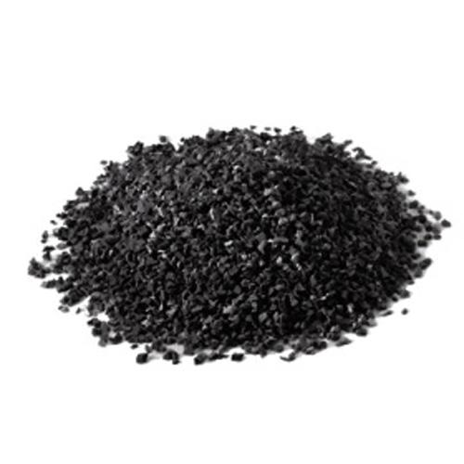
INTER-TECH
Conductive Concrete - Marconite
Carbon = Highly Conductive even in dry state Cement- Non-Corrosive and stable (Granules form)
Carbon + Cement= Conductive Concrete = Highly conductive and Non-corrosive.
Marconite is Engineered and Manufactured Product
www.intertech.com.co

Slide 8
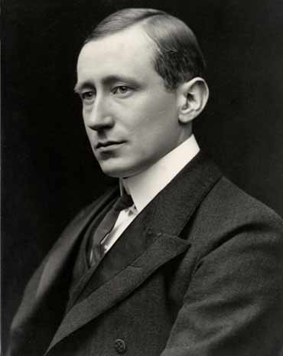
INTER-TECH
Marconite an earth enhance material was developed by Marconi company in UK, Company setup by Guglielmo Marconi, Nobel Prize winner for wireless telephony.
Marconite is an engineered product unlike the Bentonite/ Chemical earthing which is simply a natural clay
Where other product fails, Earthing specialist rely upon Marconite
www.intertech.com.co

Slide 9
INTER-TECH
Conductive Concrete Marconite as Earth Enhancing Material
Very fine powder for making excellent surface contact.
Resistant to Corrosion,
Environmentally safe.
pH Inert
Mechanically Strong
www.intertech.com.co

Slide 10
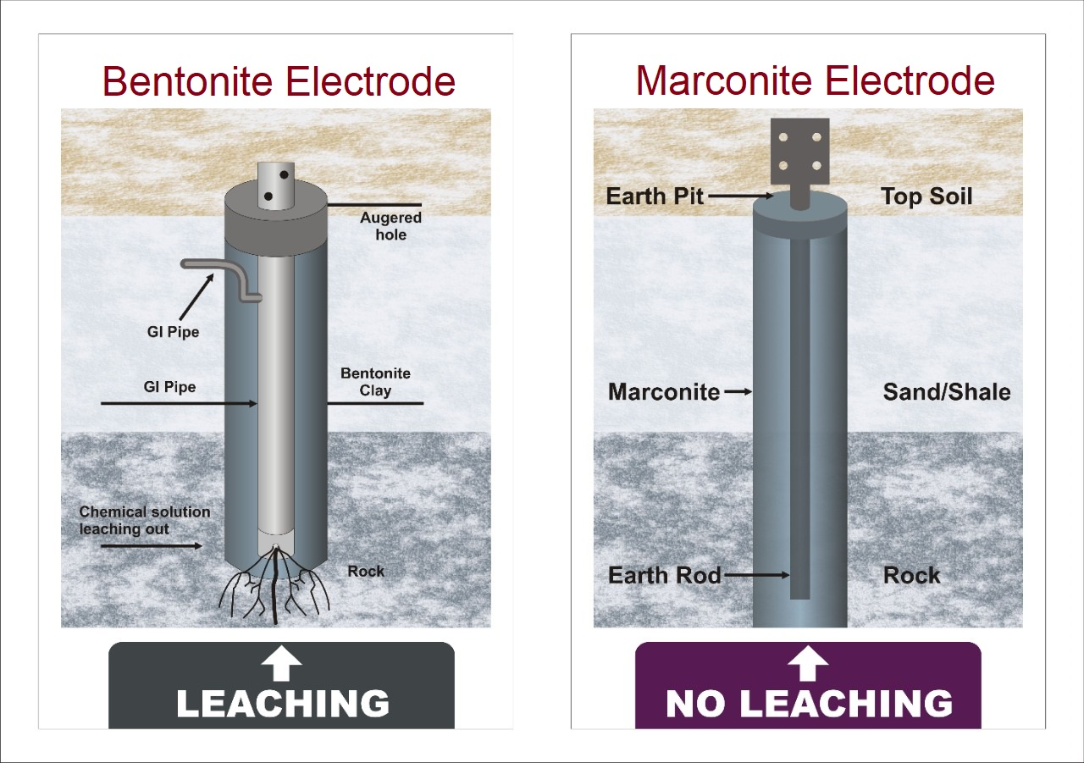
Advantage of Marconite Over Chemical Earth Enhancement Material
INTER-TECH
Chemical Leach away and
Non Polluting
Pollute Surrounding Soil
www.intertech.com.co

Slide 11
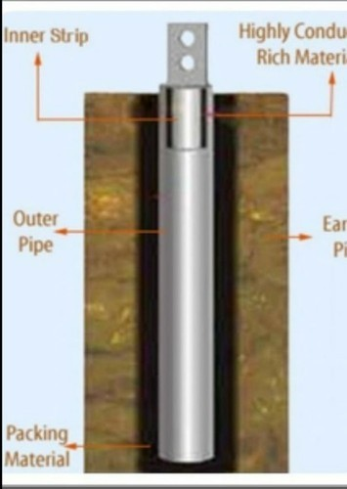
INTER-TECH
Advantage of Marconite Over Chemical
Earth Enhancement Material
Chemical Earthing
Moisture Required for Recharging
Marconite Earthing
No recharging required
www.intertech.com.co

Slide 12
INTER-TECH
Impact of Corrosion
Chemical Earthing
Marconite Earthing
Corrosion after 6-8 years
No Corrosion for 50+ years
www.intertech.com.co

Slide 13
INTER-TECH
Advantage of Marconite Over Chemical
Earth Enhancement Material
Chemical Earthing
Earthing Material crack/ shrink due to temperature rise
Marconite Earthing
Earthing Material does not crack/ shrink due to temperature rise
www.intertech.com.co

Slide 14
INTER-TECH
Tests at CPRI, Bangalore
Fault Current
40 mm & 100 mm Dia X 3 m – 80.52 kA
16 mm & 80 mm Dia X 3 m – 39.66 kA
www.intertech.com.co

Slide 15
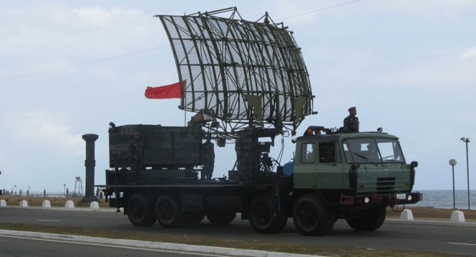
INTER-TECH
Re-locatable Electrodes for Communication lorries
www.intertech.com.co

Slide 16
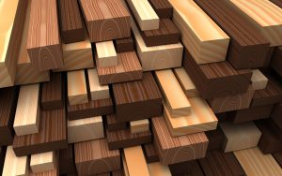
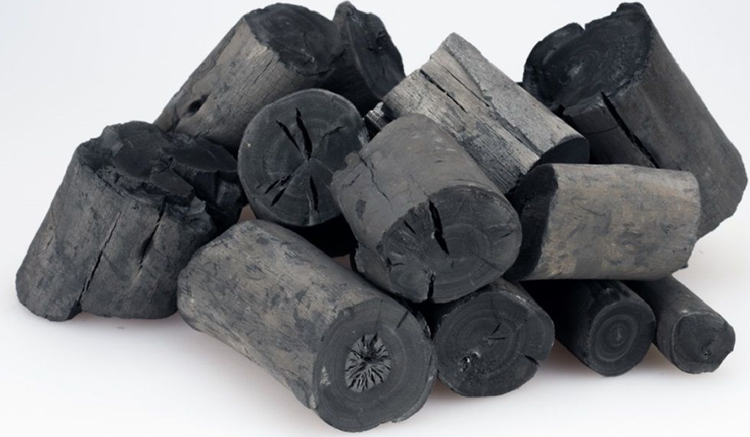
INTER-TECH
Requirement of Wood as Charcoal in Conventional Earthing
Wood
Charcoal
5kg of WOOD equals to 1KG of CHARCOAL
www.intertech.com.co

Slide 17
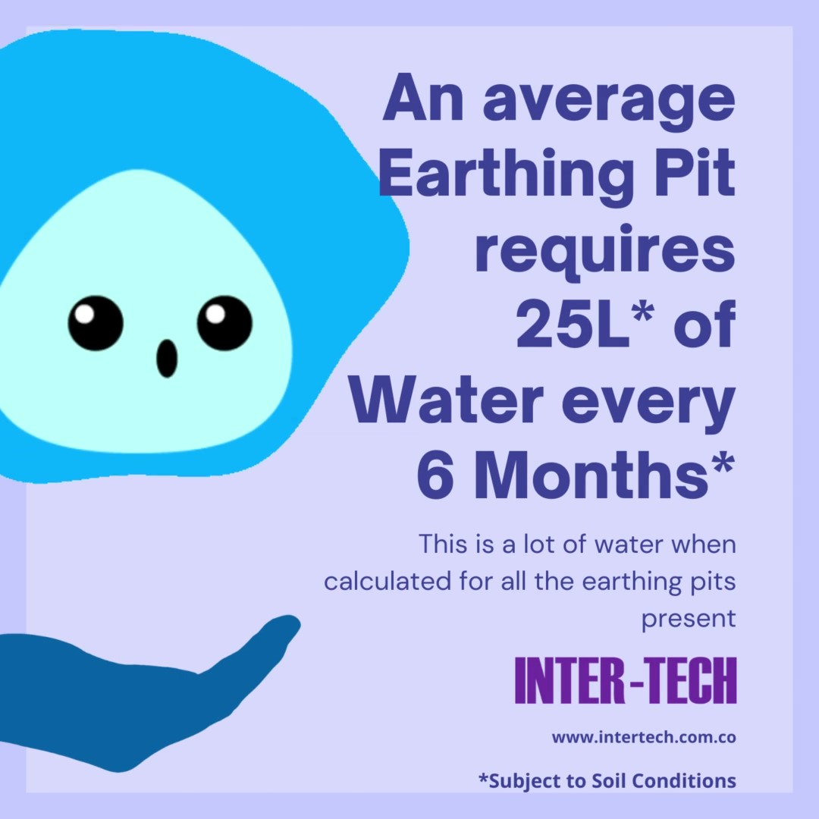
Water Requirement
INTER-TECH
Marconite Earthing doesn’t Require Water
For Life Time
www.intertech.com.co

Slide 18
Marconite a Green Earthing :
INTER-TECH
No requirement of Water
Charcoal earthing harms Trees
No Leaching therefore no Soil Pollution
Chemically Inert
www.intertech.com.co

Slide 19
INTER-TECH
Design of Earthing System
Soil resistivity
Required Resistance Values
Earth Enhancing Material
www.intertech.com.co

Slide 20
INTER-TECH
Earthing Standards
IS: 3043 : 1966, 1987 reaffirmed 2006 Code of Practice for Earthing.
Indian Electricity rules 1956 (as amended up to 2000)
IS: 2309 1989 (reaffirmed 2005) Protection of Buildings and allied Structures against lightning – Code of Practice.
IS : 2689: 1989 (reaffirmed March 2010): Guide for Control of Undesirable static Electricity.
Manual on Earthing of AC Power Systems : CBIP Publication No.302 : 2007 and 311
BS: 7430 : 1998, Code of Practice for Earthing.( formerly CP 1013: 1965) British Standard Institution London 1992
BS: 6651: 1992, Protection of Structures. Against Lightning.
IEEE :80 : 2000( Revision of IEEE Std 80: 1986) Guide for Safety in AC Substation Grounding
IEEE :142 :2007(Revision of IEEE Std 142 :1991) Grounding of Industrial and Commercial Power System.
IEEE 1100 : 2005 (Revision of IEEE Std 1100 : 1999) Powering and Grounding Electronic Equipment
www.intertech.com.co

Slide 21
INTER-TECH
Maximum Accepted Earth Resistance
The earth resistance shall be as low as possible and shall not exceed the following limits
Power stations (Gen Stn) 0.5 ohms
EHT Sub/ Stn 1.0 ohms
33 KV Sub/Stn 2.0 ohms
Distribution Xformer ) Structure 5.0 ohms
Tower Foot Resistance 10.0 ohms
US AID INDIA Book Page 92 – Modernisation of power distributions
www.intertech.com.co

Slide 22
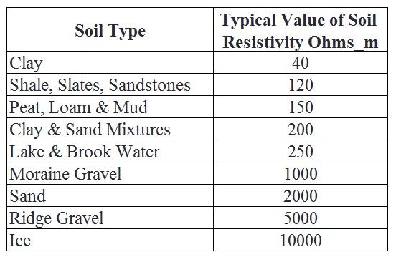
INTER-TECH
Typical Soil Resistivity Values
www.intertech.com.co

Slide 23
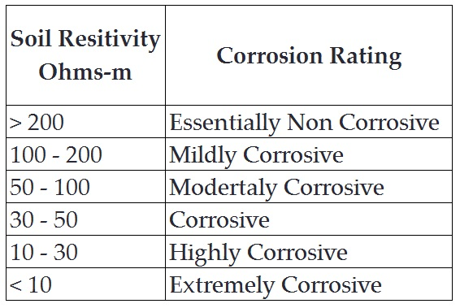
Relationship Soil Resistivity & Corrosion
INTER-TECH
www.intertech.com.co

Slide 24
INTER-TECH
Factors Affecting the Soil Resistivity
Type of the soil.
Moisture.
Dissolved salt in water.
Temperature.
Grain size and its distribution.
Seasonal variation.
Artificial treatment.
www.intertech.com.co

Slide 25
Relationship between Earth Resistance & Soil Resistivity
INTER-TECH
Earth Resistance Value is
Directly Proportional to Soil Resistivity
www.intertech.com.co

Slide 26
Typical Example of Relationship of Soil Resistivity to Achieve ER = Less than 1 Ohm
INTER-TECH
Example 1.
IAF Palam, New Delhi
Installed on - 14 December 2012
Length of Electrode -
ER Achieved – 0.76 Ohm
Signed by – Ajay Sharma, Major, Garrision Enginer
Example 2.
Prasar Bharti, New Delhi
Installed on - 08 December 2012
Length of Electrode –
ER Achieved - 0.76 Ohm
Signed by – Jitendra Sarswat, AE, DDG (E)
30 Meters
4.5 Meters
www.intertech.com.co

Slide 27
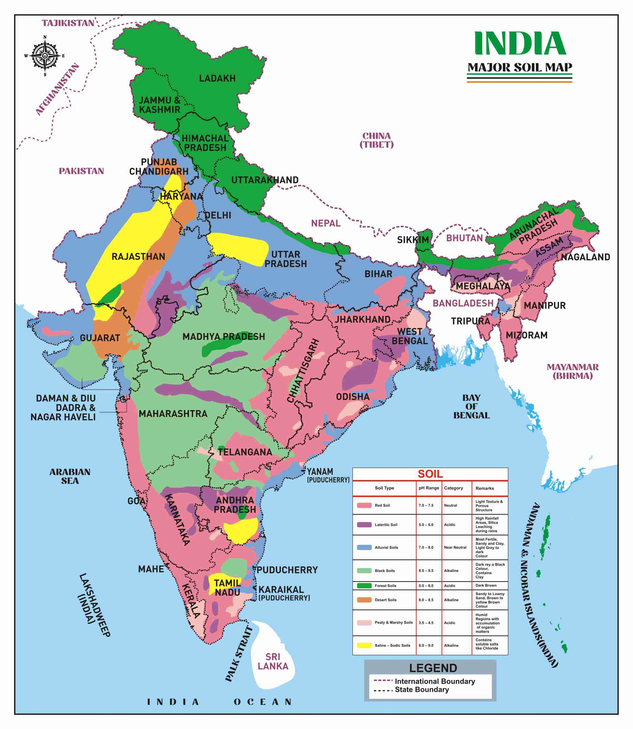
Soil pH Map of India
INTER-TECH
www.intertech.com.co

Slide 28
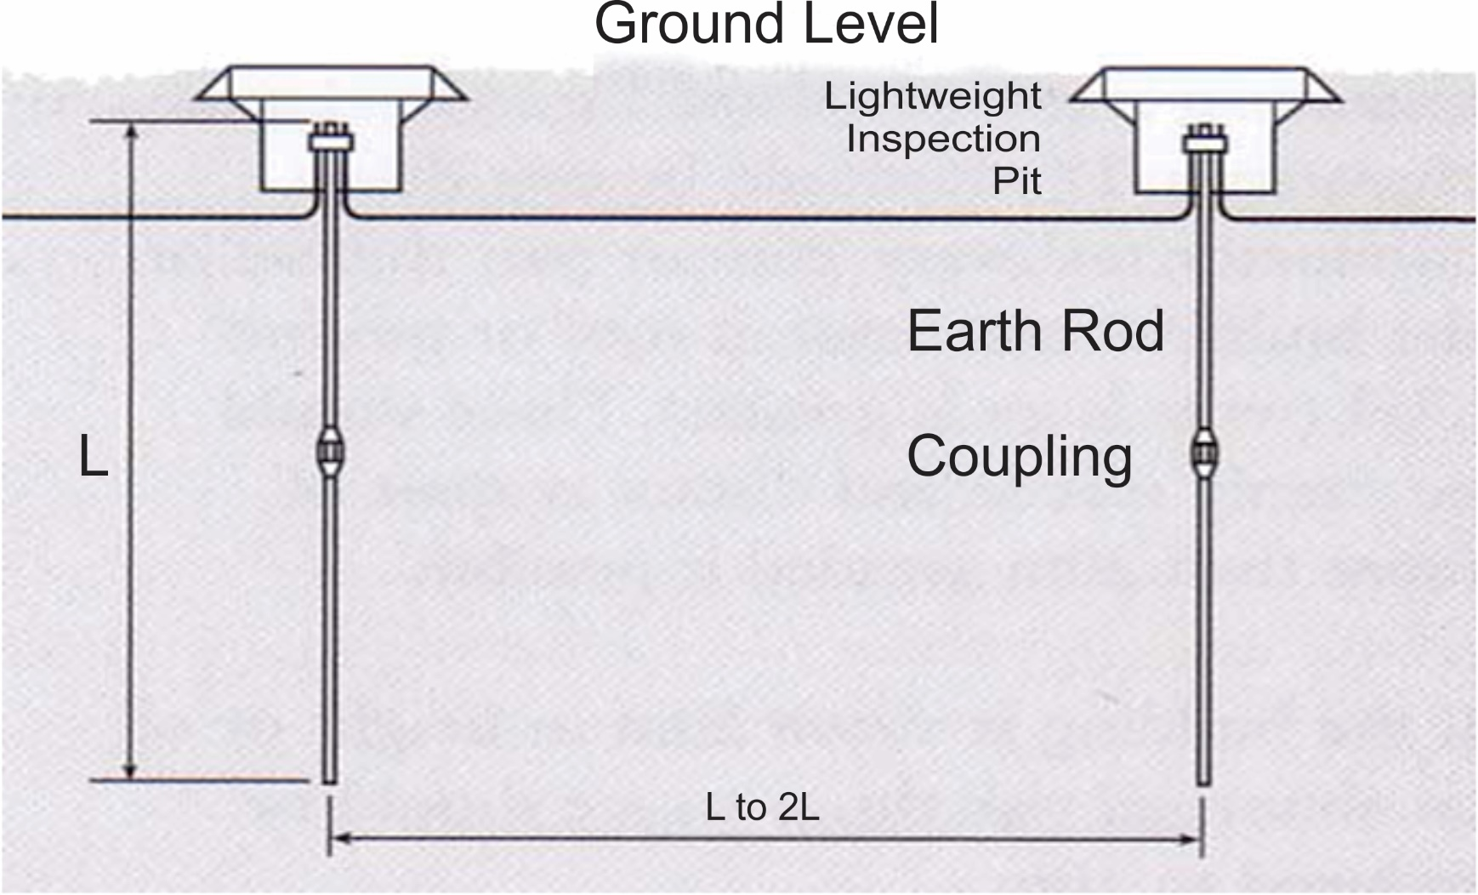
Spacing between the 2 Earth Pits
INTER-TECH
www.intertech.com.co

Slide 29
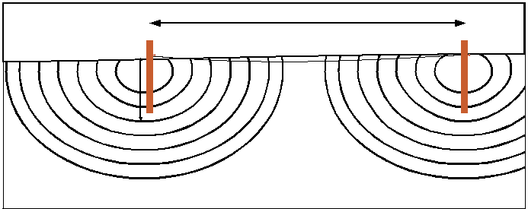
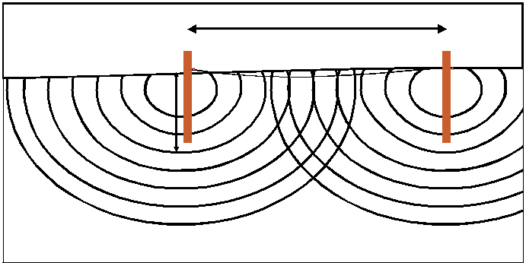
Sphere of Influence
INTER-TECH
20 ft
Effective resistance areas (no overlapping with properly spaced rods)
8 ft
www.intertech.com.co
Effective resistance areas (overlapping when rods are not properly spaced)

Slide 30
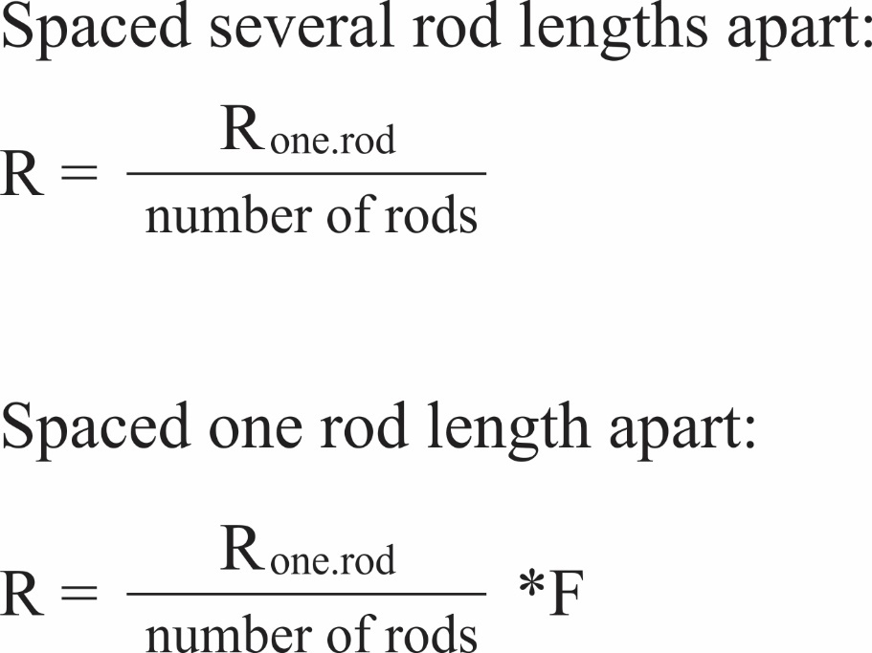
Spacing between the Multiple Earth Pits
INTER-TECH
No. of Rods | Spacing Factor
2 | 1.16
3 | 1.29
4 | 1.36
8 | 1.68
12 | 1.80
16 | 1.92
20 | 2.00
24 | 2.16
www.intertech.com.co

Slide 31
INTER-TECH
Spacing between the Multiple Earth Pits
No. of Rods | Spacing Factor
2 | 1.16
3 | 1.29
4 | 1.36
8 | 1.68
12 | 1.80
16 | 1.92
20 | 2.00
24 | 2.16
Example 1:-
= $\frac{10}{2}$ Ohms
= 5 Ohms
www.intertech.com.co

Slide 32
INTER-TECH
Spacing between the Multiple Earth Pits
No. of Rods | Spacing Factor
2 | 1.16
3 | 1.29
4 | 1.36
8 | 1.68
12 | 1.80
16 | 1.92
20 | 2.00
24 | 2.16
Example 1:-
= $\frac{10}{2}$ x 1.16
= 5 x 1.16 Ohms
= 5.8 Ohms
www.intertech.com.co

Slide 33
MYTHS & MISCONCEPTIONS
INTER-TECH
www.intertech.com.co

Slide 34
MYTH : Ground Resistance of Copper Electrode is better than Steel Electrode.
INTER-TECH
Calculation of Ground Resistance for rod / pipe electrode
$R_{g}$ = $\frac{100ρ}{2πL}\log_{e}\frac{4L}{d}Ω$
Where ρ = Resistivity of soil is ohm meter
L = Length of rod in cm
d = dia of rod in cm
R = Resistance in Ohms
Fact: Ground resistance depends upon the resistivity of the soil and dimension of the electrodes.
Material used for the electrode has no role.
www.intertech.com.co

Slide 35
INTER-TECH
Myth Increased Dia Reduces Resistance
Considering ρ = 100 Ω-m, l = 300 cm, d = 4 cm
$R_{g } = \frac{100 x 100}{2 x π x 300}log n\frac{4 x 300}{4}$Ω
$= 5.30516477 x 5.703782475 =30.26Ω$
Considering ρ = 100 Ω-m, l = 300 cm, d = 8 cm
$R_{g } = \frac{100 x 100}{2 x π x 300}log n\frac{4 x 300}{8}$Ω
$= 5.30516477 x 5.010635294 =26.58Ω$
www.intertech.com.co

Slide 36
INTER-TECH
Myth Increased Dia Reduces Resistance
Change in Resistance between 40 mm & 80 mm diameter pipe/rod is
= $\frac{30.26−26.58}{30.26}$ x 100 = 12.16 %
OBSERVATION:
Doubling the diameter decreases the Ground resistance by 10 to 12%
www.intertech.com.co

Slide 37
INTER-TECH
FACT - Length Reduces the Resistance Value
Considering ρ = 100 Ω-m, l = 100 cm, d = 4 cm
$R_{g}= \frac{100 x 100}{2 x π x 100}\log{n}\frac{4 x 100}{4}Ω$
$=15.9154943 x 4.60517018=73.29Ω$
Considering ρ = 100 Ω-m, l = 200 cm, d = 4 cm
$R_{g}= \frac{100 x 100}{2 x π x 200}\log{n}\frac{4 x 200}{4}Ω$
$=7.95774715 x 5.29831736=42.16Ω$
www.intertech.com.co

Slide 38
INTER-TECH
FACT - Length Reduces the Resistance Value
Considering ρ = 100 Ω-m, l = 300 cm, d = 4 cm
$R_{g}= \frac{100 x 100}{2 x π x 300}\log{n}\frac{4 x 300}{4}Ω$
$=5.30516477 x 5.703782475=30.26Ω$
www.intertech.com.co

Slide 39
INTER-TECH
FACT - Length Reduces the Resistance Value
Change in resistance when the length is doubled
$= \frac{73.29 −42.16}{73.29}=42.47\%$
Change in resistance when the length is increased to 3 mtr
$= \frac{73.29 −30.26}{73.29}=58.71\%$
OBSERVATION:
- By doubling the length resistance decreases by 40%
- By trebling the length resistance decreases by 60%
www.intertech.com.co

Slide 40
MYTH: More water in the earth pit reduces the Ground resistance
INTER-TECH
Ground resistance depends upon the soil resistivity at a location.
Moisture is one of the factors that reduces the earth resistivity
Presence of moisture helps in decrease in earth resistance.
But this has the limit as shown in the curve. It is upto 20% moisture.
www.intertech.com.co

Slide 41
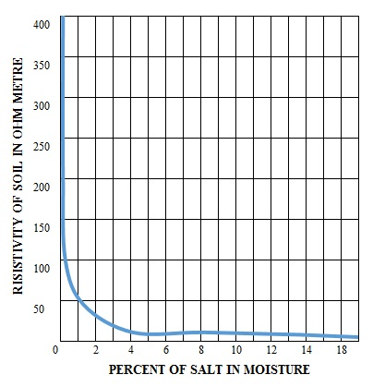
INTER-TECH
Effect of Salt on Soil resistivity
It can be seen from the diagram the curve flattens at 5% of salt in moisture
Further increase in soil content will give less impact to decrease the soil resistivity
The salt content is expressed in % by weight of moisture content in soil
www.intertech.com.co

Slide 42
INTER-TECH
Effect of Salt on Soil resistivity
Considering 1 cubic mtr of soil, the moisture content is 10% i.e. 144Kg. (10 % of 1440Kg of soil).
The salt content should be 5% of 144Kg i.e. 7.2Kg.
So, further addition of salt will have no impact
www.intertech.com.co

Slide 43
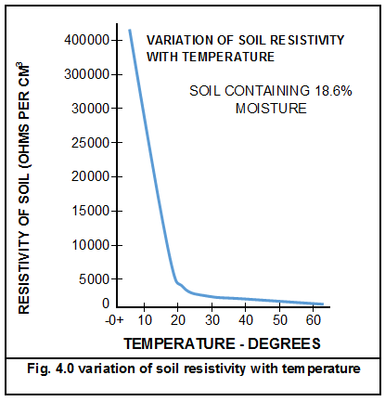
Effect of soil temperature on soil resistivity
INTER-TECH
Temperature also has an effect on soil resistivity
Effect is Predominant at or near zero degree celsius
www.intertech.com.co

Slide 44
INTER-TECH
Techno Commercial Comparison of Marconite V/s Bentonite
Property | Bentonite | Marconite
Resistivity | 2.5 – 5.5 Ω m | 0.001 Ω m
Maintenance Recharge of Water/ Backfill | Yes | No
Materials pH | 9-10 Alkaline | 6.9 Inert
Corrosion impact of Backfill on conductor | Yes | No Green Product
Per Year Corrosion impact on conductor | 0.0028 mm Per Year | 0.0010 mm Per Year
Leaching/ Shrinkage/ Cracks | Yes | No
www.intertech.com.co

Slide 45
INTER-TECH
Techno Commercial Comparison of Marconite V/s Bentonite
Property | Bentonite | Marconite
Corrosion impact of surrounding soil on earth enhancement material | Yes | No
Non-Polluting/ Environment Friendly | No | Yes
Deeper Installation | No | Yes
Performance Consistency for Life cycle | No | Yes
Conduction | Ionic (Presence of Water) | Electronic (Movement of Electrons)
www.intertech.com.co

Slide 46
INTER-TECH
Techno Commercial Comparison of Marconite V/s Bentonite
Description | Bentonite | Marconite
Plant Life | 50 Years | 50 Years
Life Cycle of Earthing | 6-8 Years | 50+ Years
Replacement Frequency During Plant Life | 6 Times | 1 Times
Initial Cost (in Soft Soil) | 8,000/- | 16,500/-
Total Cost | 8,000 x 6 = 48,000 | 16,500 x 1 = 16,500
Maintenance Cost cost | 20,000 | Nil
Total Life cycle Cost | 68,000 | 16,500
www.intertech.com.co

Slide 47
Marconite Installations
INTER-TECH
www.intertech.com.co

Slide 48
INTER-TECH
Marconite Customers in India
www.intertech.com.co

Slide 49
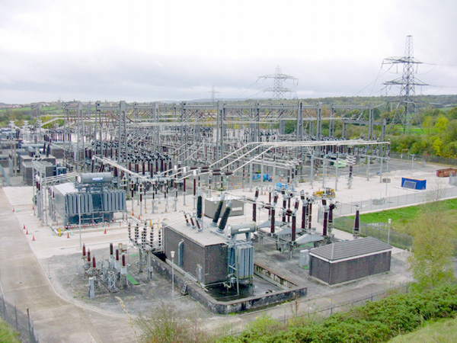
INTER-TECH
MARCONITE IN USE AT UTILITIES
NEW DELHI MUNICIPAL COUNCIL
11 kV S/stn - Chanderlok Building, Janpath
11 kV S/stn – Rohit House, Tolstoy Marg
33kV S/stn – Bapu Dham, Dhaula Kuan (Rocky Area)
RAJASTHAN VIDYUT VITRAN NIGAM LIMITED
220 kV GIS S/stn – Nalagarh Power House, Jaipur
220 kV GIS S/stn – MNIT, Jaipur
KERALA STATE ELECTRICITY BOARD (ALL SUB-STATIONS IN ROCKY AREA)
66 kV S/stn – kochupumpa – Distt Pathanamithitta
110 kV S/stn – Enathu – Distt Pathanamithitta
110 kV S/stn – Varkala – Distt Trivandrum
110 kV S/stn – Mevlikara – Distt Allepy
www.intertech.com.co

Slide 50
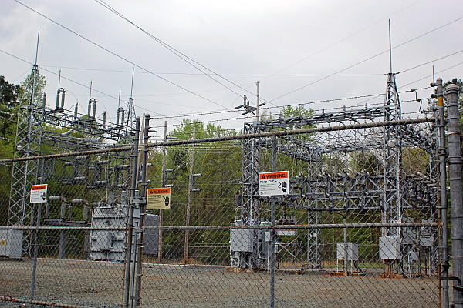
INTER-TECH
MARCONITE IN USE AT UTILITIES
MAHATRANSCO MUMBAI (ROCKY AREA)
110 kV S/stn – Roha
100 kV S/stn – Dombivili
KARNATAKA POWER TRANSMISSION CORPORATION LIMITED (ROCKY AREA)
700 mW Thermal Power Station – Baillari (Rocky Area)
UP POWER CORPORATION LIMITED, LUCKNOW (ROCKY AREA)
400 kV ESS – Chappartalla, Allahabad
CHATTISGARH STATE POWER TRANSMISSION CORPORATION LIMITED (ROCKY AREA)
132 kV S/Stn – Dallirajhara
www.intertech.com.co

Slide 51
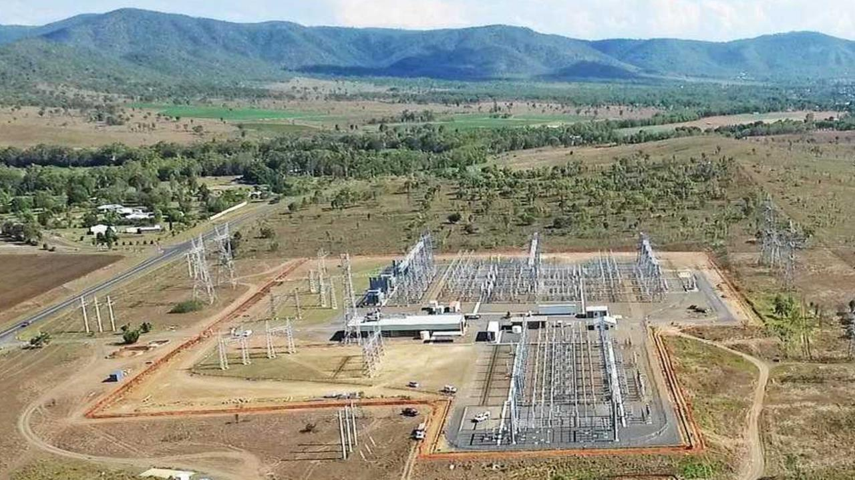
INTER-TECH
MARCONITE IN USE AT UTILITIES
BSES – RAJDHANI POWER LIMITED (RELIANCE POWER)
66 kV S/stn – Nangloi, Delhi
66 kV S/stn – Sangum, Delhi
66 kV S/stn – SEA University, Vasant Kunj
66kV S/stn - Dwarka, Delhi
BHUTAN POWER CORPORATION (ROCKY AREA)
66 kV S/Stn – Thimpu, Bhutan
MEIL (Western UPPCL, Hapur)
765 kV S/Stn- Hapur (Under Exceution)
www.intertech.com.co

Slide 52
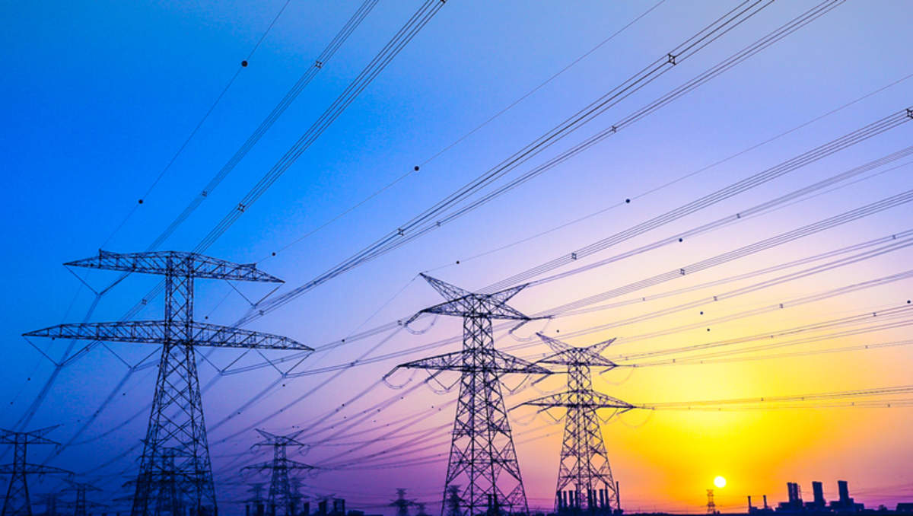
INTER-TECH
MARCONITE IN USE IN TRANSMISSION NETWORK
PGCIL - 220 KV D/C ALIPURDUAR- SALAKATI
PGCIL - 400/220/132 KV GIS S/S – RANGPO
www.intertech.com.co

Slide 53
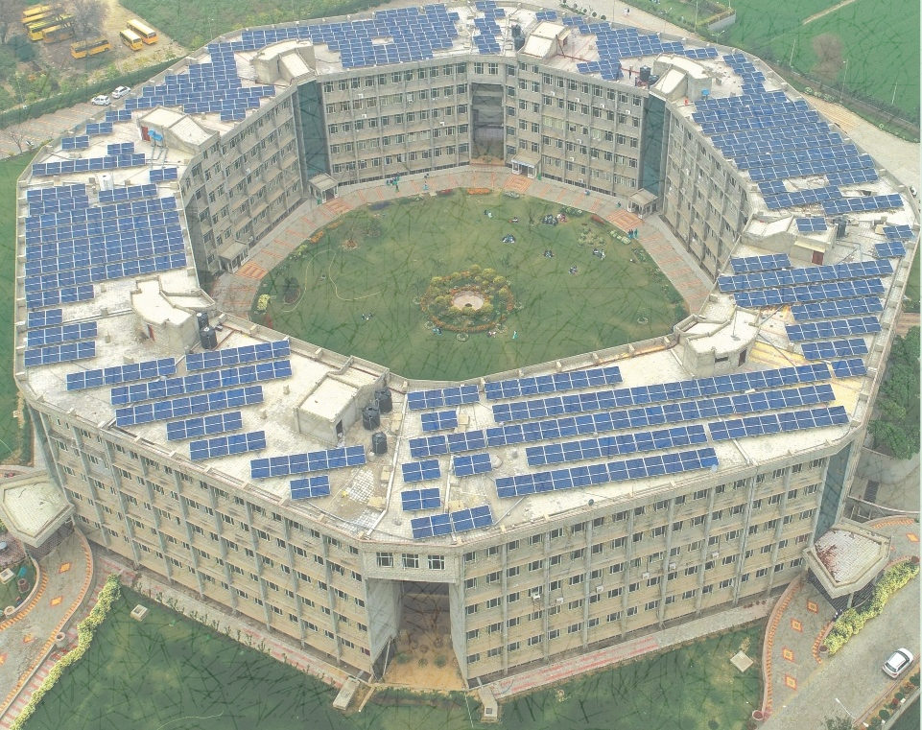
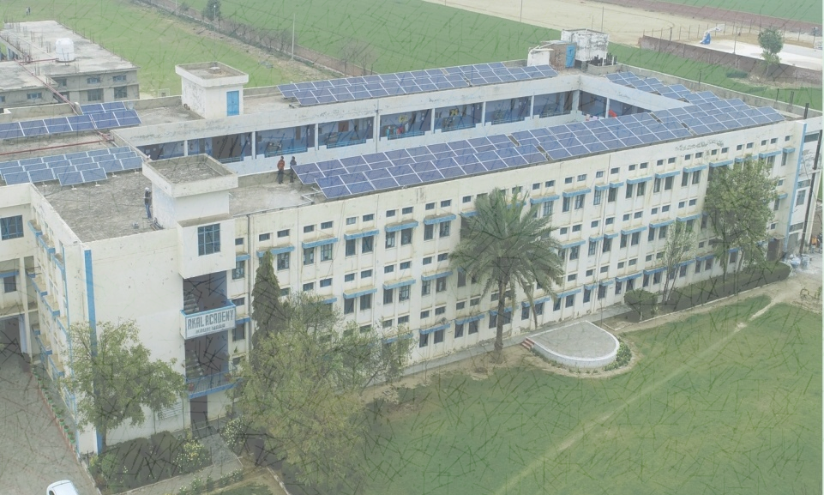
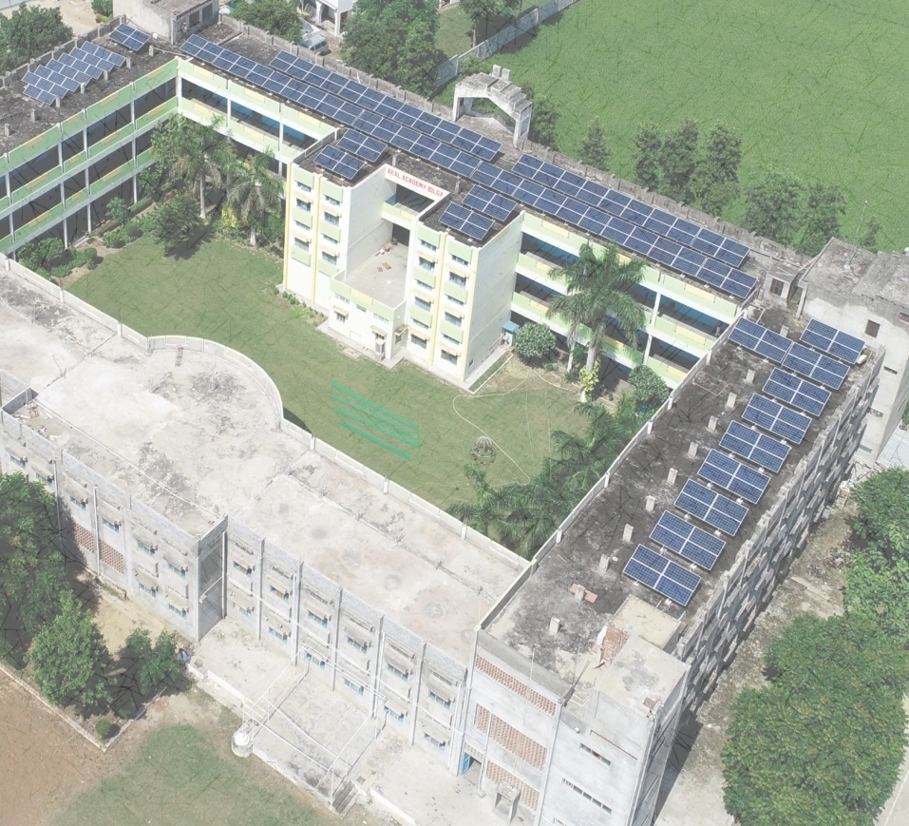
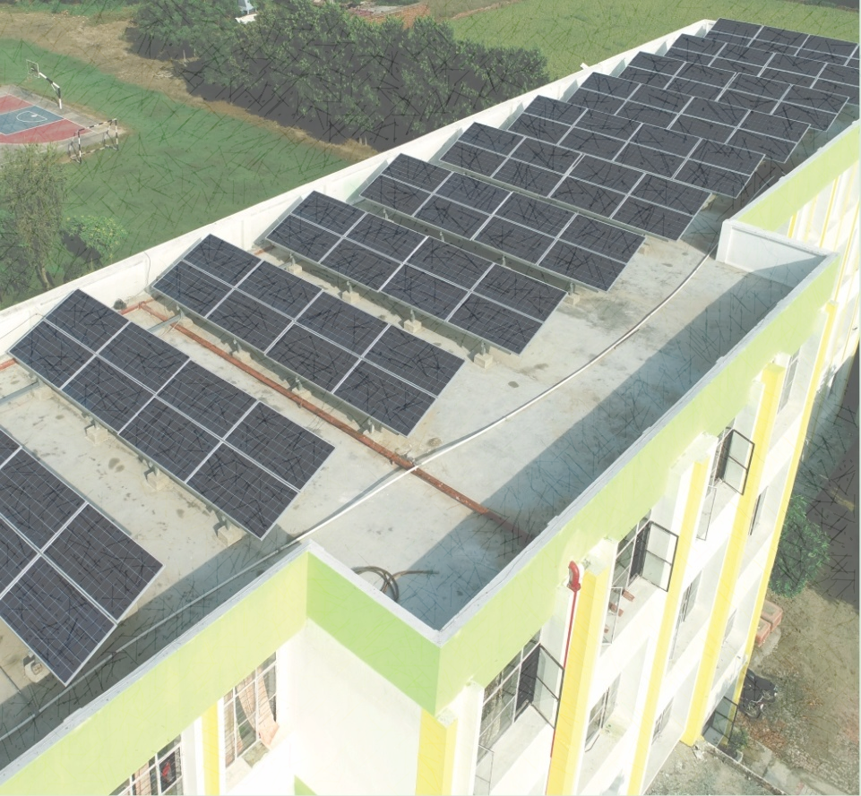
INTER-TECH
Roof Top- Solar Plants
750 kW Akal University, Bhatinda
1500 kW 40 Akal Academies, Punjab
108 kW Radaur, Haryana
75 kW Mukund Lal Public School, Yamuna Nagar
85 kW ICICI Bank Ltd, Noida
www.intertech.com.co

Slide 54
INTER-TECH
Ground Mounted Projects - In Pipe line
22 MW Haldiram
6 MW Renew Power- Nagarjuna cement
1.6 MW DS Group
145 MW NTPC, Ramagundam, Telangana
www.intertech.com.co

Slide 55
INTER-TECH
Ground Mounted Projects - In Pipe line
22 MW – Renew Power, Cumbum
30 MW MULKANOOR, Telangana
143 MW DACHPALLI, Telangana
640 MW Bikaner, Rajasthan
www.intertech.com.co

Slide 56
Hospitals
INTER-TECH
Apollo Hospital, Delhi
Saral Diagnostic Lab, Delhi
Saket City Hospital, Delhi
Venketeshwar Hospital, Delhi
RR Hospital, Delhi Cantt, Delhi
www.intertech.com.co

Slide 57
Industries
INTER-TECH
Dr Oetker India, Bhiwari
CIPLA Ltd., Maharshtra
Dalmia Cement, Gurgaon
Ambuja Cement
Dalmia Cement, Maharshtra
Indian Oil Refineries, Panipat
Bhushan Steel Ltd., UP (Now TATA Steel BSL)
www.intertech.com.co

Slide 58
Power Sector
INTER-TECH
CSPTCL, Bhilai
Torrent Power, Agra
Zesco, Lusaka, Zambia
Adani Power, Ahmadabad
DDL – Tata Power, New Delhi
Ballary Thermal Power Station, Ballary
Karnataka Power Corp. Ltd., Bangalore
NDMC 33 kV ESS Bapudham, New Delhi
KSEB ltd 66 kV ESS at Kochupampa, Kerala
Maha Transco 100 kV ESS Roha, Maharashtra
RRVPNL 220 kV GIS Nala Power House, Jaipur
www.intertech.com.co

Slide 59
Defence
INTER-TECH
GE (North) Af Palam, New Delhi
CWE (Utility) Mes, Delhi Cantt.
HQ 5 Signal Group, New Delhi
Rafale Training Centre, Hasimara
Rafale Training Centre, Ambala
Cod, Delhi Cantt
MCTE, Mhow
Dr Oetker India, Bhiwari
www.intertech.com.co

Slide 60
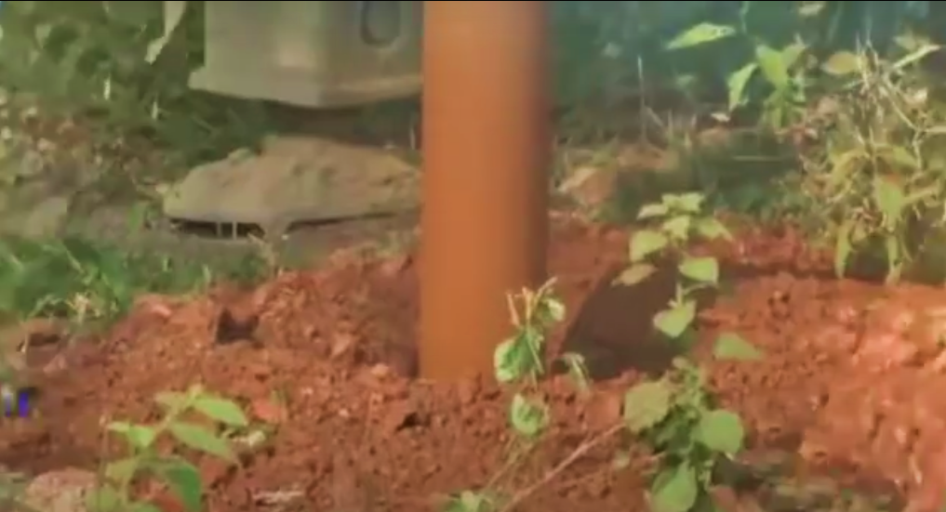
INTER-TECH
We have installed Pan India
30000 + Marconite Earth Pits
Where 'No’ maintenance or Water
is required for the Next 50 years
www.intertech.com.co

Slide 61
INTER-TECH
Year Wise cumulative growth of Installation of Marconite Electrodes at TATA Steel BSL Ltd.
www.intertech.com.co

Slide 62
INTER-TECH
Year Wise cumulative growth of Installation of Marconite Electrode at Apollo Hospital
www.intertech.com.co

Slide 63
INTER-TECH
Life Cycle of Solar Plant - 25 Years
Marconite with life cycle of 25+ Years
Marconite Performs for 25+ Years without water
Replacement every 7-8 years
EARTHING
EARTHING
EARTHING
BOS
Managed by O&M
INVERTER
Warranted by manufacturer
SOLAR MODULE
Warranted by manufacturer
5 Years
10 Years
15 Years
20 Years
25 Years
www.intertech.com.co

Slide 64
INTER-TECH
Where does your investment go?
General Breakup of your Investment is
www.intertech.com.co

Slide 65
INTER-TECH
Where does your investment go?
General Breakup of your Investment is
www.intertech.com.co

Slide 66
INTER-TECH
Where does your investment go?
General Breakup of your Investment is
www.intertech.com.co

Slide 67
INTER-TECH
Where does your investment go?
General Breakup of your Investment is
www.intertech.com.co

Slide 68
INTER-TECH
Where does your investment go?
General Breakup of your Investment is
www.intertech.com.co

Slide 69
INTER-TECH
Where does your investment go?
General Breakup of your Investment is
www.intertech.com.co

Slide 70
Common Mistakes in Earthing
INTER-TECH
Not measuring/understanding soil resistivity
Improper design
Lesser spacing between the earth pits
Non periodical inspection
Improper spacing from the nearby wall
www.intertech.com.co

Slide 71
Do’s
INTER-TECH
Inspect earth electrode, once in a year and clean terminal and apply rust preventive spray
Ensure terminal of earth electrode is properly cleaned of corrosion before any Measurement is taken
Ensure good and reliable electrical connection between earthing terminal leads and application
www.intertech.com.co

Slide 72
Don’ts
INTER-TECH
Don’t locate any element like power cable, underground tank, rain water drain or another earth pit etc. in sphere of influence of existing earth electrode.
Don’t put any water or chemical in marconite earth pits.
Don’t take measurement while earthing is connected to an application.
www.intertech.com.co

Slide 73
Managing values of desired resistance
INTER-TECH
it was also observed in some installations that the earth pit is filled to the top with salt and charcoal (this too, just days before the Electrical Inspector is due to arrive for inspecting the installation). This is a wrong practice.
If the moisture content is already above 20 percent, there is no point in adding barrels of water into the earth pit, except perhaps wasting an important and scarce national resource like water.
www.intertech.com.co

Slide 74
INTER-TECH
Conclusion- Ensuring a good Earthing system
Measure Soil Resistivity
Design as per desired resistance values
Ensure proper spacing between rods and nearby walls.
Periodic check of resistance values
www.intertech.com.co

Slide 75
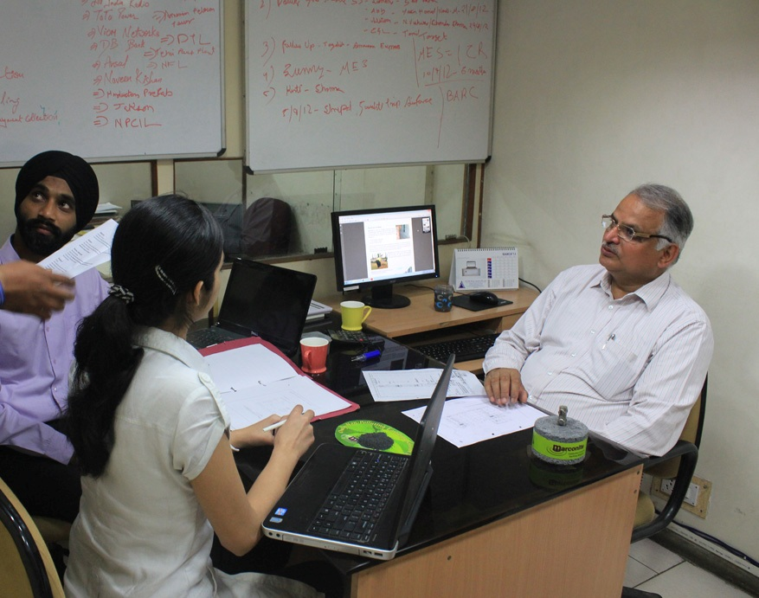
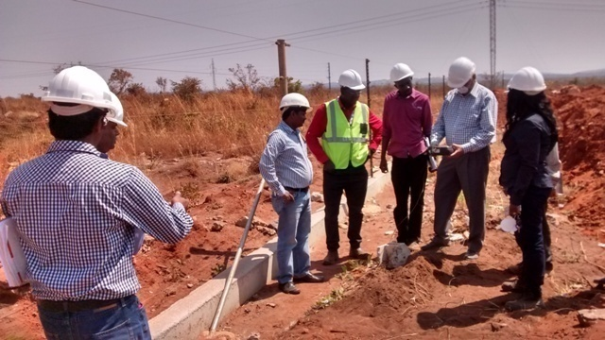
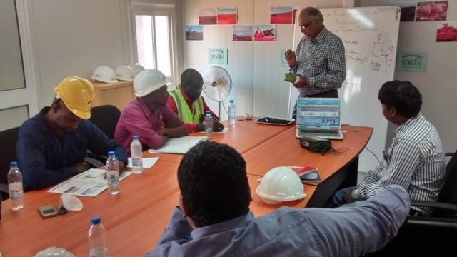
INTER-TECH
Value Added Solution by INTER-TECH
www.intertech.com.co

Slide 76
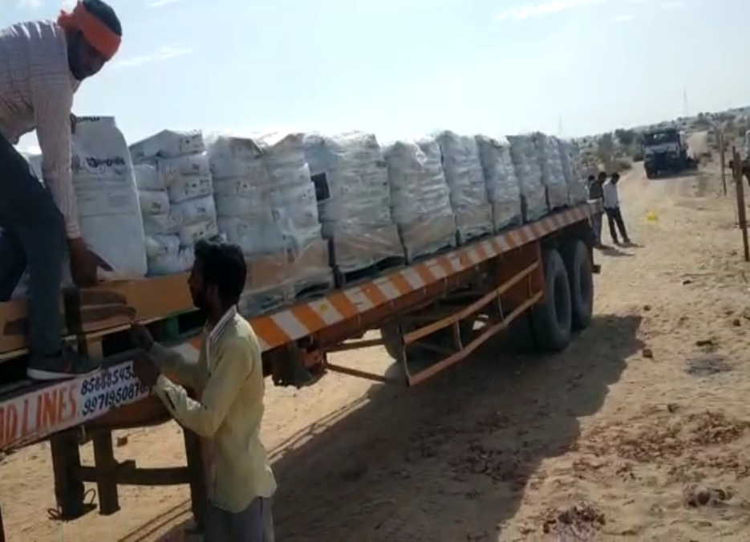
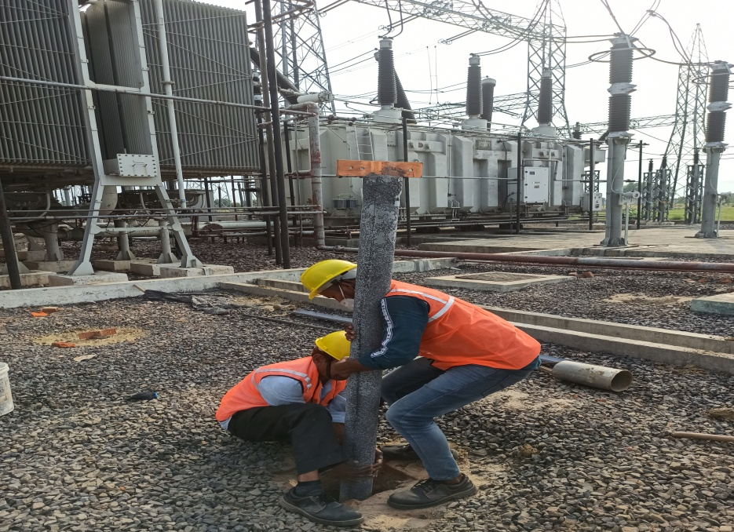
Recent Projects
INTER-TECH
Material for 6000 Earthings for 650 mW Solar Plant in Bikaner
765 kV Switch Yard at UPPTCL, Hapur
www.intertech.com.co

Slide 77
INTER-TECH
Performance Warranty
Rafale Training Centre, IAF Ambala
50⁺ Years Life Cycle
50⁺ Years Life Cycle
JASOLA METRO
» Installation Date : 04/2019
» Performance
Warrantee upto : 04/2044
» Earth Pit No :
» Resistance Value :
» Reading Date :
» Next Reading on :
*No Water *No Recharge
» Installation Date : 08/2019
» Performance
Warrantee upto : 08/2044
» Earth Pit No :
» Resistance Value :
» Reading Date :
» Next Reading on :
*No Water *No Recharge
www.intertech.com.co

Slide 78
INTER-TECH
Testimonials
We adopted Marconite conductive Concrete Technology for around 100 nos treated earth pits in rocky soil and we could achieve the desired earth resistance as per our client’s requirement.
G. Eyathirajulu,
Sr Manager Electrical & CI
The performance report of earth electrode encased in Marconite conductive concrete was measured and was found to be 1.84 Ohms which is satisfactory.
S M Naik,
Sr. Maintenance Manager (Electrical)
www.intertech.com.co

Slide 79
INTER-TECH
Testimonials
Marconite conductive concrete is used for our Electron Beam Centre, Navi Mumbai network to achieve earth pit resistance of 0.65 Ohms. We are glad to get these maintenance free earthing station having less than 1 Ohms.
RI Bakhtsingh,
Scientific Officer (Electron Bea Centre)
KSEB installed 70 electrodes at its kochupampa 66 kv substation in rocky terrain. The earth resistance measured after 3 weeks of installation was 0.8 ohms which was earlier more than 50 ohms.
Executive Engineer
Kochupampa Substation,
Kerala State Electricity Board
.
www.intertech.com.co

Slide 80
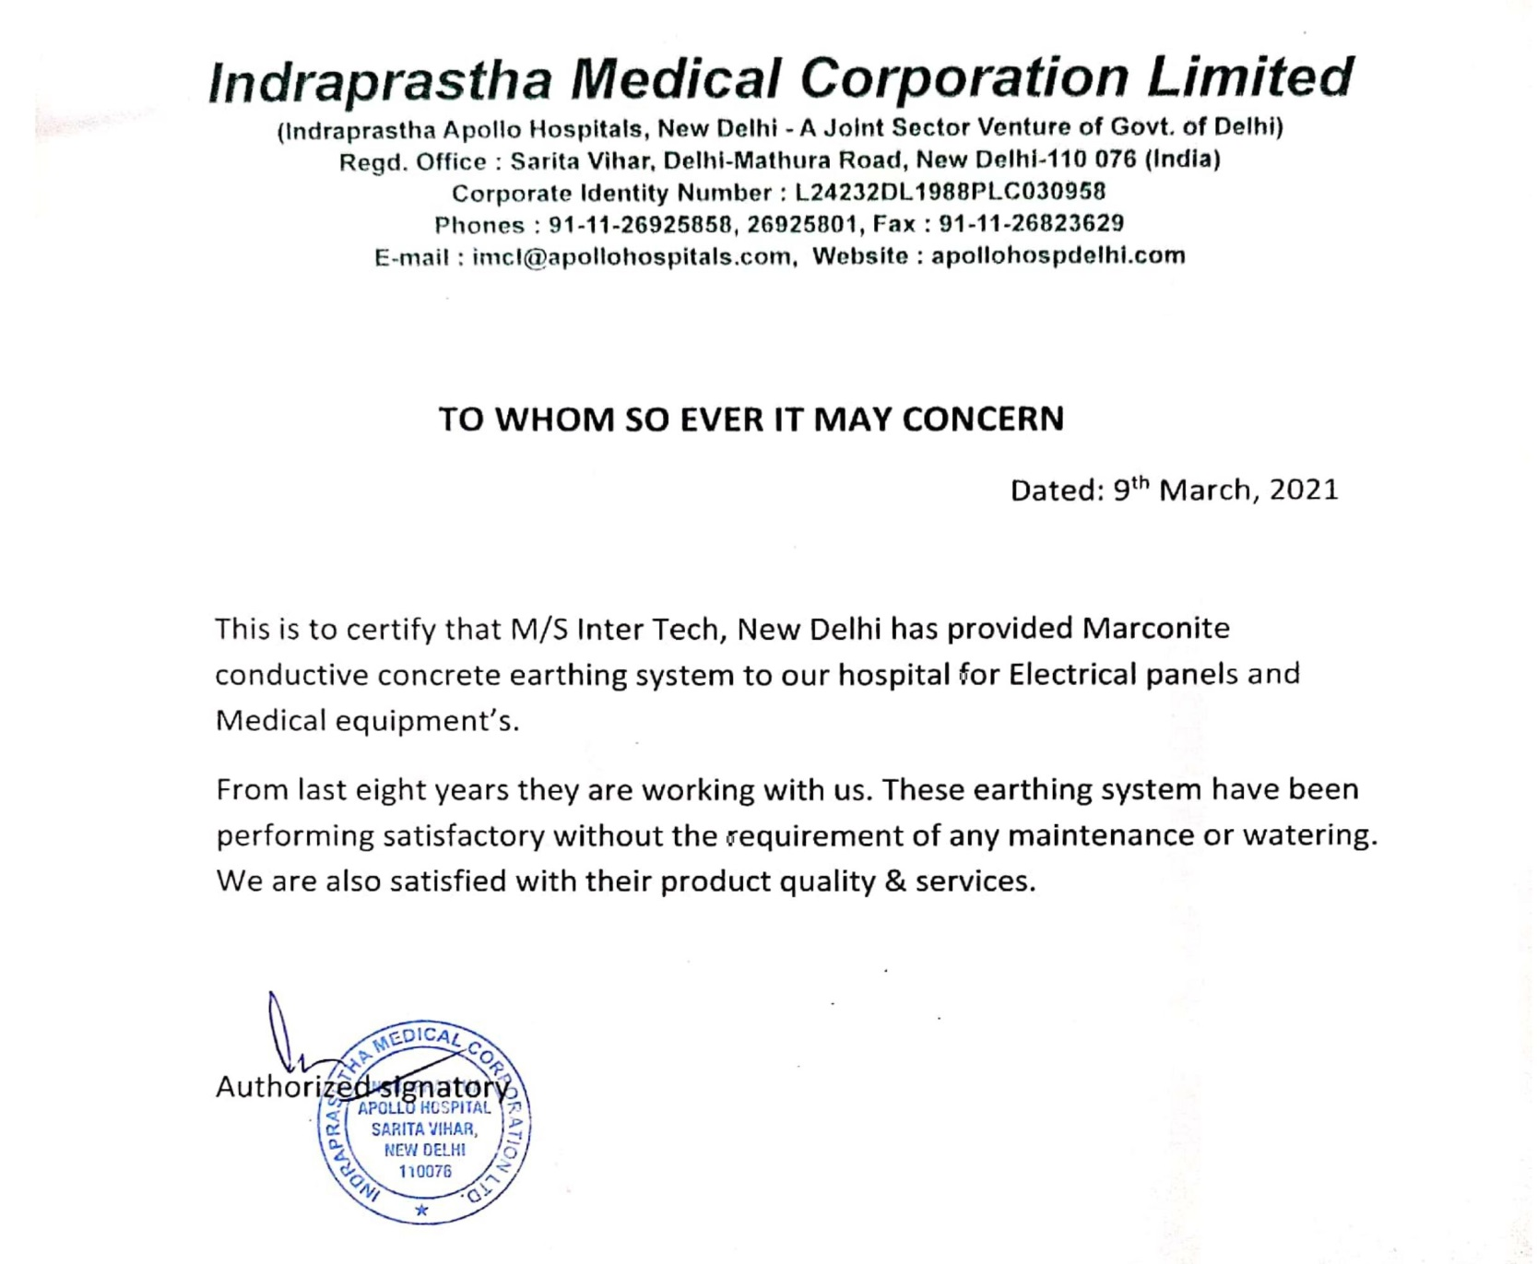
INTER-TECH
www.intertech.com.co

Slide 81
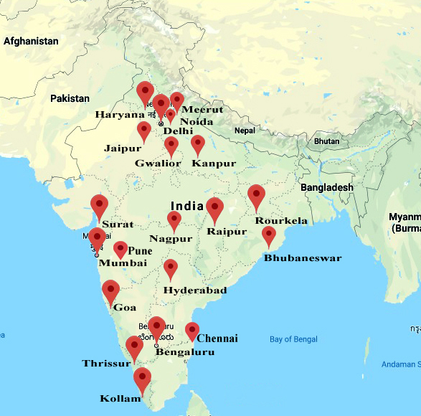
INTER-TECH
Channel Partners of
INTER-TECH
in India
www.intertech.com.co

Slide 82
INTER-TECH
Provides you Earthing for
Where other materials fail,
Earthing specialists rely upon
www.intertech.com.co

Slide 83
INTER-TECH
www.intertech.com.co

